Slide 1
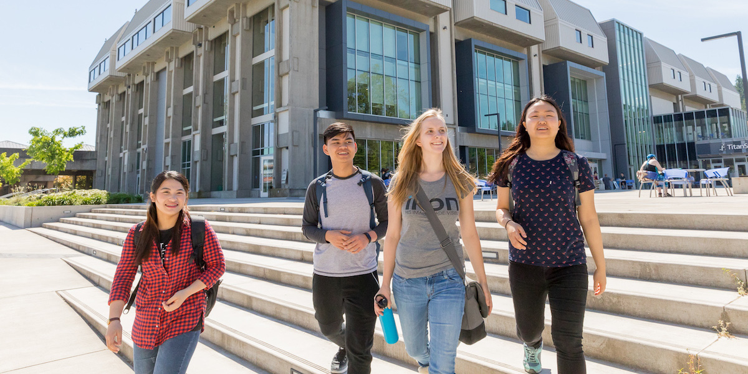
Guided Pathways at Lane Community College
Centering the Student Experience
With an Equity Lens
To Improve Student Outcomes

Slide 2
Guided Pathways Framework
The Guided Pathways (GP) Framework outlines a student-centric approach to whole-college redesign focused on improving the student experience by creating clearer pathways to program completion, employment, and further education.
At the heart of this transformation is equitable support for all students from any starting point through achievement of their desired outcome.
The goal is an institution-wide shift in the student experience through redesign of academic programs, support services, and systems, resulting in increased student success.

Slide 3
Four Pillars of Guided Pathways
Institutional Action Perspective
Clarify the Path
Help Students Get on a Path
Help Students Stay on their Path
Ensure Students are Learning
I
II
III
IV

Slide 4
The Loss Momentum Framework
Student Experience Perspective
External Factors: Federal, State, Local Policy, Accreditation, Economy, Labor Market
Connection
Interest to application
Entry
Enrollment to
completion of
gateway course
Progress
Entry into course of study though 75% of requirements completed
Completion
Complete a certificate, degree, or credential with labor market value
Transition
Successful transition to university or workforce
Strong links to high schools & community
Links to labor markets and 4-years
Do not apply to postsecondary education
Poor academic preparation
Low-income students often need to combine work and school; work over 20 hours/week; schedule changes
Limited advising leads to credit & debt accumulation
Community college credits don’t transfer to 4-year institution
Delayed entry into postsecondary education
Large rate of referral to developmental education
Leave without math credits
Common Loss Points
Leave college with excess credits
Lack of coordination leads to under-enrollment, poor program matching, and failure to obtain financial aid for which they qualify
Part-time enrollment means slow progress; loss of momentum
Transfer without credential
Don’t pass program-level math & writing in 1st year
Credential isn’t stackable or doesn’t garner family-level wage
Leave college without support for job search or no career plans
Life disruptions cause some students to drop out
Lane’s Strategies
Lane’s activities that support students to build momentum

Slide 5
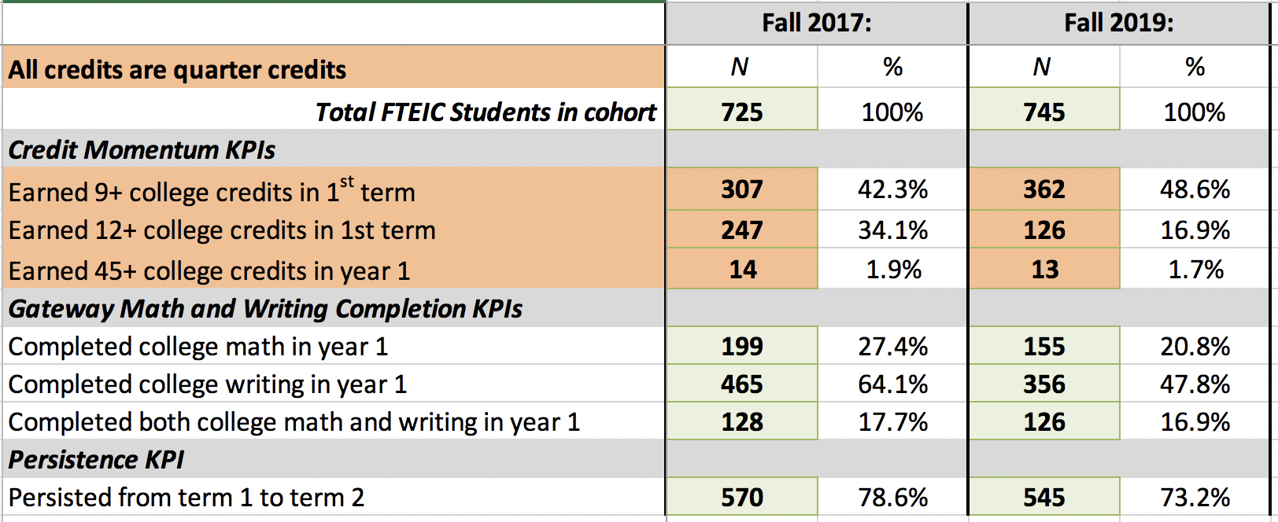
Lane’s Early Momentum Metrics (EMMs)

Slide 6
Aspirations
In at least 20 content areas within the AAOT, students entering Fall 2021 will select their first term courses based on a Default Academic Plan (DAP).
In Fall 2021, students will have an opportunity to enroll in a credit First Year Experience (FYE) course which provides strategies to achieve their goals, and supports them in career exploration, and academic and financial planning.
Student-centric redesign and implementation of easier-to-use software systems, TargetX and EAB Navigate, that improve the student experience of entry processes, and intra-college communication with and about students.

Slide 7
Current Status
Proposed
Not started/forming
In Progress/working
Complete or On Track
Team and Project Status
Internal Communication, Mapping Process, On-Ramp, Cross-Content, and Student Engagement Team
These teams completed their research and design work which is being incorporated into current work
Data Team
Developed metrics; Evaluating effects of implementation
Default Academic Plans (Maps)
15 Drafts In-Progress
First Year Experience & Career Exploration
V.1 for F21: Outcomes developed, Curriculum approval
Placement
Included in Entry Reform AY22 Goal
Coordinating Committee
Defining AY22 Goals
Overall Project Status:
The pandemic caused us to refocus our efforts. This year work progressed most on Default Academic Planning (Mapping), and First Year Experience with Career Exploration.

Slide 8
Decision Making and Reporting
Design
Teams
Coordinating Committee
President and Provost
Core Team
Stakeholders
Authorization and support for implementation, request for revision, or disapproval.

Slide 9
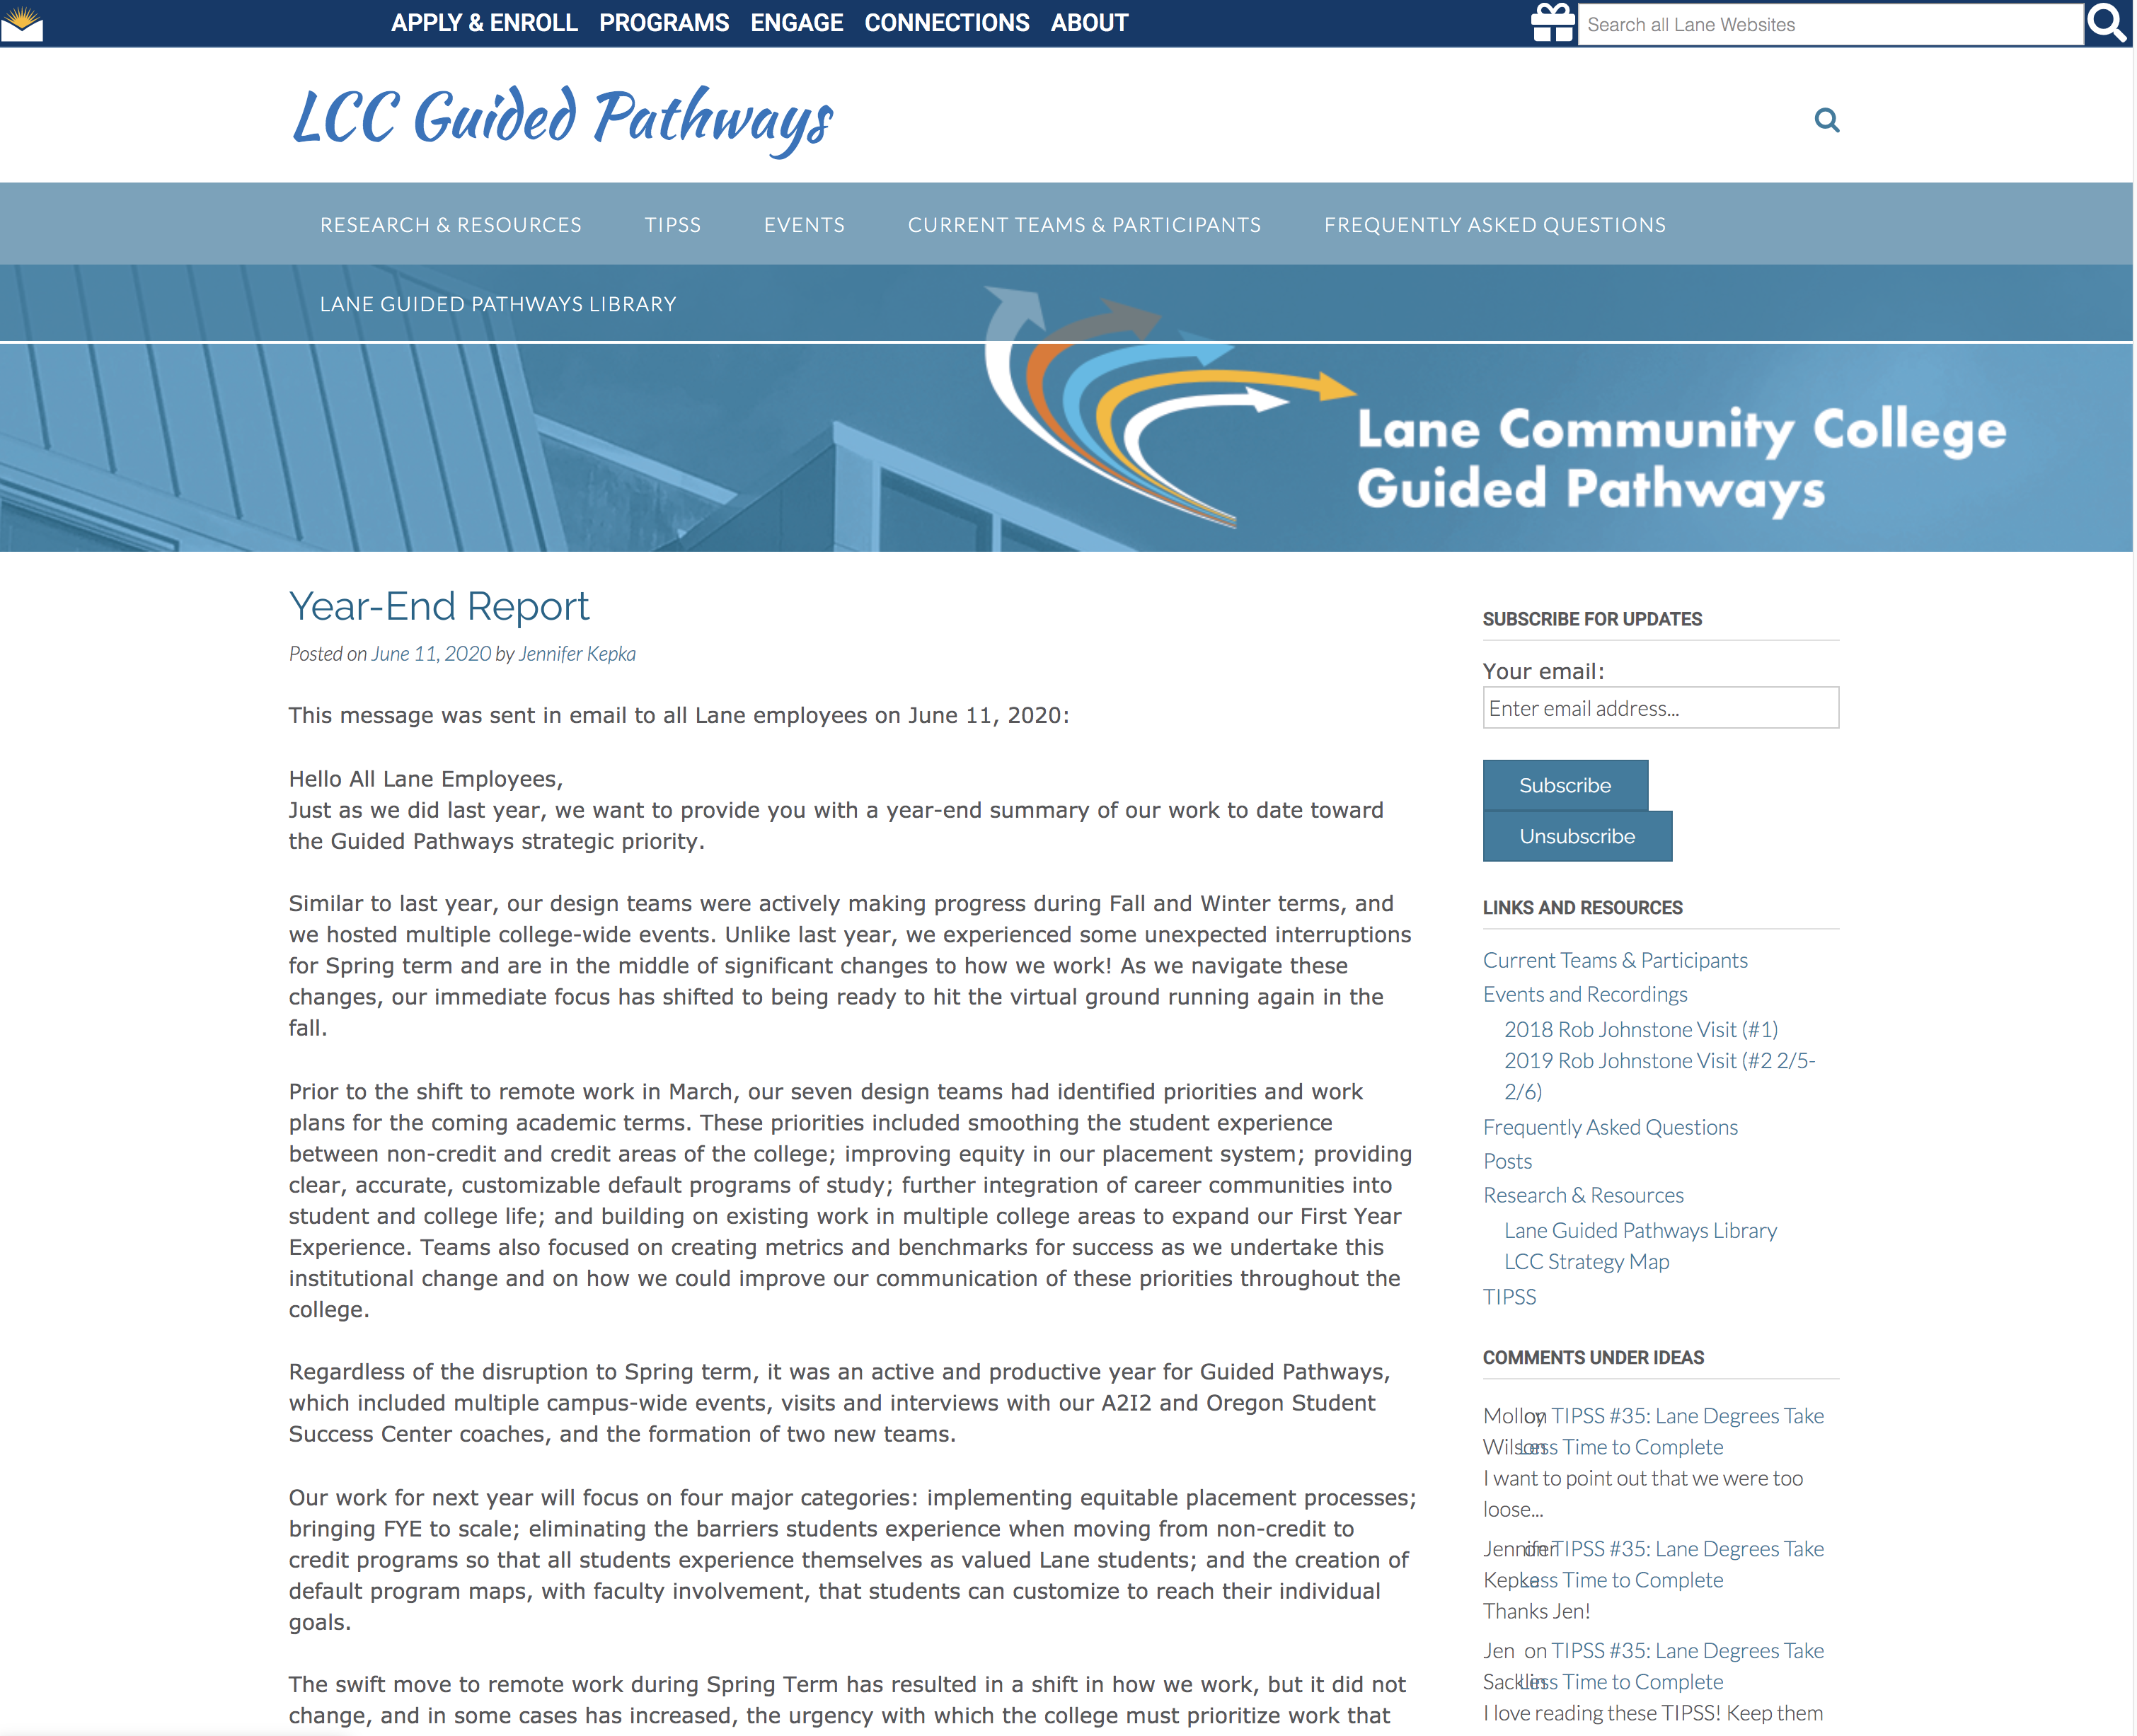
How You Can Contribute
Learn:
Guided Pathways Blog
https://blogs.lanecc.edu/guidedpathways/
CCRC – Community College Research Center
Achieving The Dream (ATD)
Lane Spring Conference 2021
Discuss:
Four Pillars and/or Loss Momentum Framework in department meetings.
Request Guided Pathways Presentation/Discussion in department or division.
Act:
Center the Student Experience in all that you do.
Apply and share the Four Pillars and Loss Momentum Frameworks in your daily conversations, decisions, and actions.
Apply the Equity Lens.
Review, consider, and use student success and outcome data in your decision making.
Make local decisions with your colleagues from the perspective of the student experience.
Join and contribute to GP design teams.

Slide 10
Leadership Teams
Guided Pathways Core Team
Jennifer Frei
AVP, School of Arts & Sciences, and Guided Pathways
freij@lanecc.edu
Mindie Dieu
AVP, Student Affairs
dieum@lanecc.edu
Jenn Kepka
Faculty, Academic Technology
kepkaj@lanecc.edu
Mike Sims
Project Coordinator
School of Arts & Sciences, and Guided Pathways
simsm@lanecc.edu
Guided Pathways Coordinating Committee
Anna Gates-Tapia
Andi Graham
Beth Landy
Casey Reid
Cathy Thomas
Chris Rehn
Christine Andrews
Cybele Higgins
Dawn Whiting
Gina Szabady
Jane Reeder
Josh Baker
Lori Areford
Russ Pierson
Sarah Nemecek
Tammi Garlock

Slide 11
Centering the Student Experience
With an Equity Lens
To Improve Student Outcomes

Slide 12
Spring Conference
Dr. Hana Lahr
Senior Research Associate and Program Lead
Community College Research Center
Keynote Address: Connecting Data, the Student Experience, and Our Work
Breakout Session: Lane’s Early Momentum Metrics: Predictors of Long-Term Student Success
Breakout and On-Demand Sessions
Closing Session: Student Panel on Becoming a Student-Ready College

